Slide 1


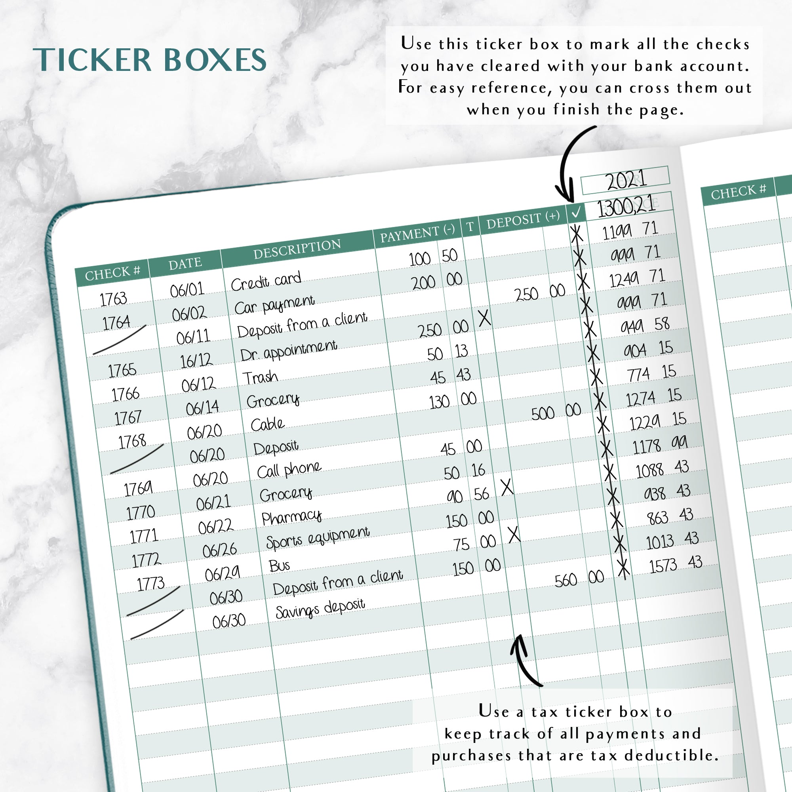


What is Financial Reconciliation?
Compares two sets of records to ensure the money spent is equal to the money leaving from your bank account. It helps manage the financial accuracy and prevents fraud.
Example:
Discrepancy = 300 USD
Compare Ledger with Bank Records
Found that billed twice at sports shop
Bank Statement= 10,200 USD
Got charged twice= 300 USD
Get Refund of 150 USD
Bank Statement= 10,350 USD
Money Transfer Fee= 150 USD
Reduce 150 from Ledger
Ledger Statement= 10,350 USD
My Ledger Balance = 10,500 USD

Slide 2

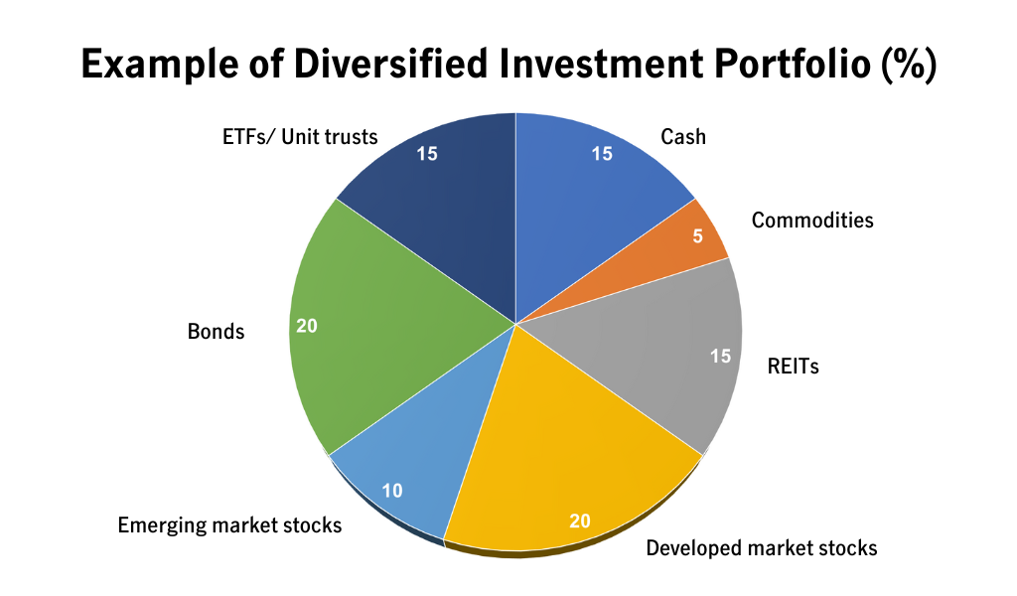

WE ADVISE AND CREATE PORTFOLIOS
Give Cash
Invest Money
Release Cash
BANKS- Cash Deposit
CLIENTS/BUSINESS
Sell Assets
Release Assets
CUSTODIAN- Securities Deposit
WHY RECONCILIATION IS NEEDED
EFFECTS OF RECONCILIATION
Ameriprise General Ledger- WE SIDE | Bank Data Feed- THEY SIDE
20100_001_INP_GBP_100 | 001_INR_GBP_95
28967_002_INR_GBP_200 | 002_INP_GBP_200
30200_003_INP_GBP_300 | 003_INR_GBP_300
40200_004_INR_USD_400 | 004_INP_USD_450
50200_005_INR_JPY_500 | 005_INP_JPY_500
Ensures Accuracy
Prevents Fraud
Compliance and Audit Readiness
Improves Cash Flow Management
Supports Informed Decision-Making

Slide 3
Golden Source
INVEST 1
Work Day
NA & EMEA Property Team
Internal Reconciliation
Controllership Team
FAS Team
Tech Team
Security Codes
NA Ledger Data
General Ledger Extract (daily & Monthly)
HORIZON
Finance Support
Bug Fixing etc.
Paul, Joshua etc.
EMEA Property Ledger Data
Reconciliation Reports
FRONTIER
(Reconciliation)
Manual Input
Scrubbed Data
NAS Folder
MFT
Security
Cash
Custodian/Banks
NAS Folder
Power BI Reports
SPIDER
CARTS
Subledger related data in Ameriprise
Payment Trans & Balances
PAM
Term Loan Holdings
EMEA Custodian Holdings & Tranx
NA Custodian Holdings & Tranx
For General Ledger Recon
Black Mountain Everest
WSO
Black Mountain Everest
FIS Bank Data
Black Mountain Everest
Line of Entry
Cheques
SWIFT
Input

Slide 4
What We Do?/BAU
Who We Are?
Tech-Support for Frontier which is tool developed in JAVA by Trintech
Automates the reconciliation process and generates Balance and Suspense Reports
Utilized by Controllership, Cash Recon, Security Recon, FAS Team etc.
Three major modules: Rec-Admin, Re-Collector and Recon Frontier
Scrubber development for ~45 custodians
Onboarding new accounts to Frontier for Reconciliation
Onboarding of new users to Frontier
Data scrubber maintenance
Extend support to Ops team in prod Issues
Tidal-job failure issues

Slide 5


